Slide 1
CONTENTS
Intro 00:02:01
1 JavaScript Basics 00:14:48
2 Numbers and Math 00:43:26
3 Strings 01:07:32
4 HTML CSS Review, console.log 01:51:06
5 Variables 02:32:55
6 Booleans and If-Statements 03:34:12
7 Functions 04:15:45
8 Objects 05:25:46
9 Document Object Model (DOM) 06:38:51
10 HTML, CSS, and JavaScript Together 07:42:28

Slide 2
CONTENTS
11 Arrays and Loops 08:43:04
11 (Part 2) Arrays and Loops 09:28:26
12 Advanced Functions 10:10:22
12 (Part 2) Advanced Functions 10:58:57
13 Start the Amazon Project and Intro to Git 12:28:00
14 Modules 13:56:33
15 External Libraries 15:34:37
16 Testing 15:58:24
Testing Frameworks 17:36:30

Slide 3
CONTENTS
17 Object-Oriented Programming 18:06:09
Classes 18:51:50
Inheritance 19:32:59
18 Intro to Backend, Callbacks, Async Await 20:30:57
Promises and fetch 21:12:47
Async Await 22:14:09
Next steps after this course 22:15:56

Slide 4
ROADMAP
Contents | Date | Status
Intro | 18/11 | DONE
JavaScript Basics
Numbers and Math
Strings | 20/11 | DONE
HTML CSS Review consolelog
HTML CSS Review consolelog | 21/11 | DONE
Variables
Variables | 24/11 | DONE
Booleans and IfStatements
Booleans and IfStatements | 25/11 | DONE
Functions
Functions | 26/11 | DONE
Objects

Slide 5
Objects | 28/11 | DONE
Document Object Model DOM
Document Object Model DOM | 01/12 | DONE
HTML CSS and JavaScript Together
Arrays and Loops | 02/12 | DONE
Arrays and Loops | 03/12 | DONE
Part Arrays and Loops
Part Arrays and Loops | 05/12 | DONE
Advanced Functions
Advanced Functions | 08/12 | DONE
Part Advanced Functions
Part Advanced Functions | 09/12 | DONE
Start the Amazon Project and Intro to Git
Start the Amazon Project and Intro to Git | 10/12 | DONE
Start the Amazon Project and Intro to Git | 12/12 | DONE
Modules

Slide 6
Modules | 15/12 | DONE
Modules | 16/12 | DONE
External Libraries
External Libraries | 17/12 | DONE
External Libraries | 19/12 | DONE
Testing
Testing Frameworks | 22/12 | DONE
Testing Frameworks | 23/12 | DONE
ObjectOriented Programming | 24/12 | DONE
Classes | 26/12 | DONE
Inheritance | 29/12 | DONE
Intro to Backend Callbacks Async Await | 30/12 | DONE
Intro to Backend Callbacks Async Await | 31/12
Promises and fetch
Promises and fetch | 02/01
Async Await
Async Await | 05/01
Next steps after this course

Slide 7
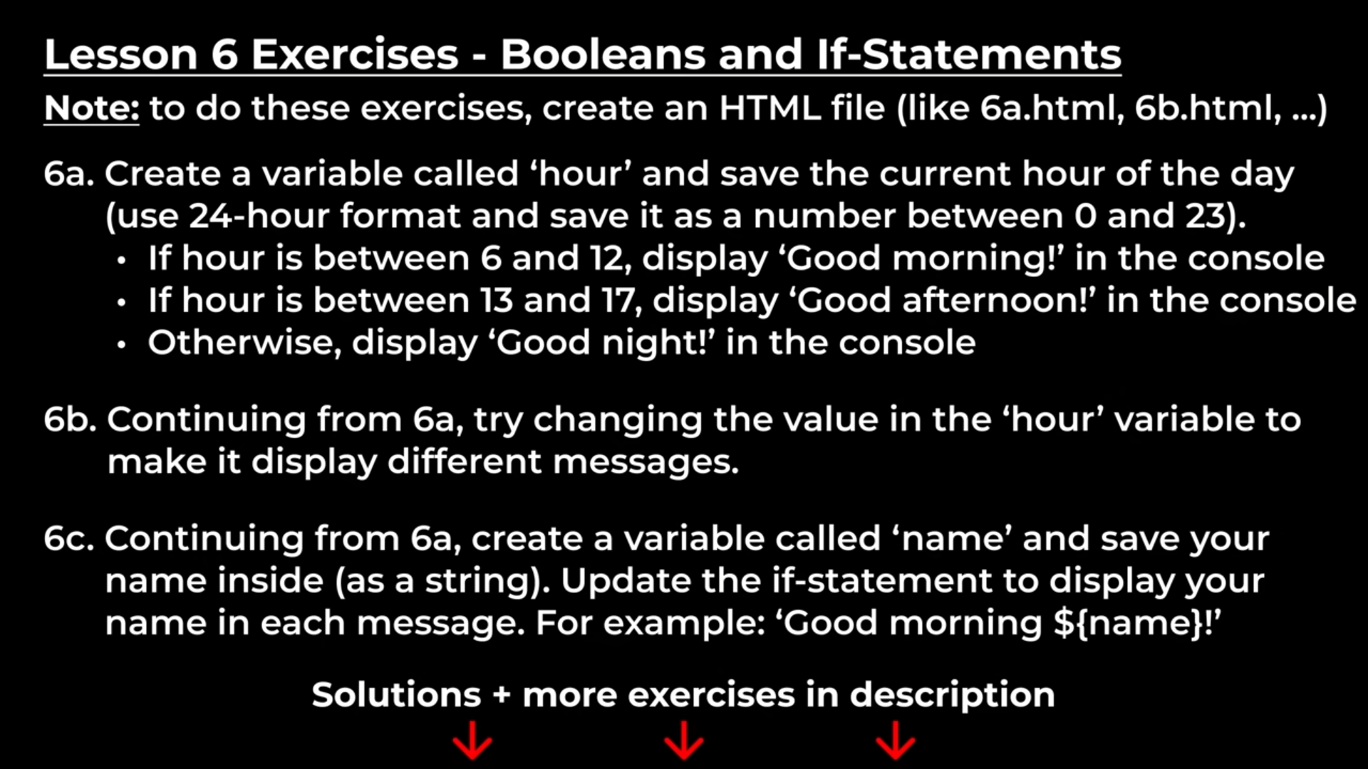
Practiss the exercises in

Slide 8
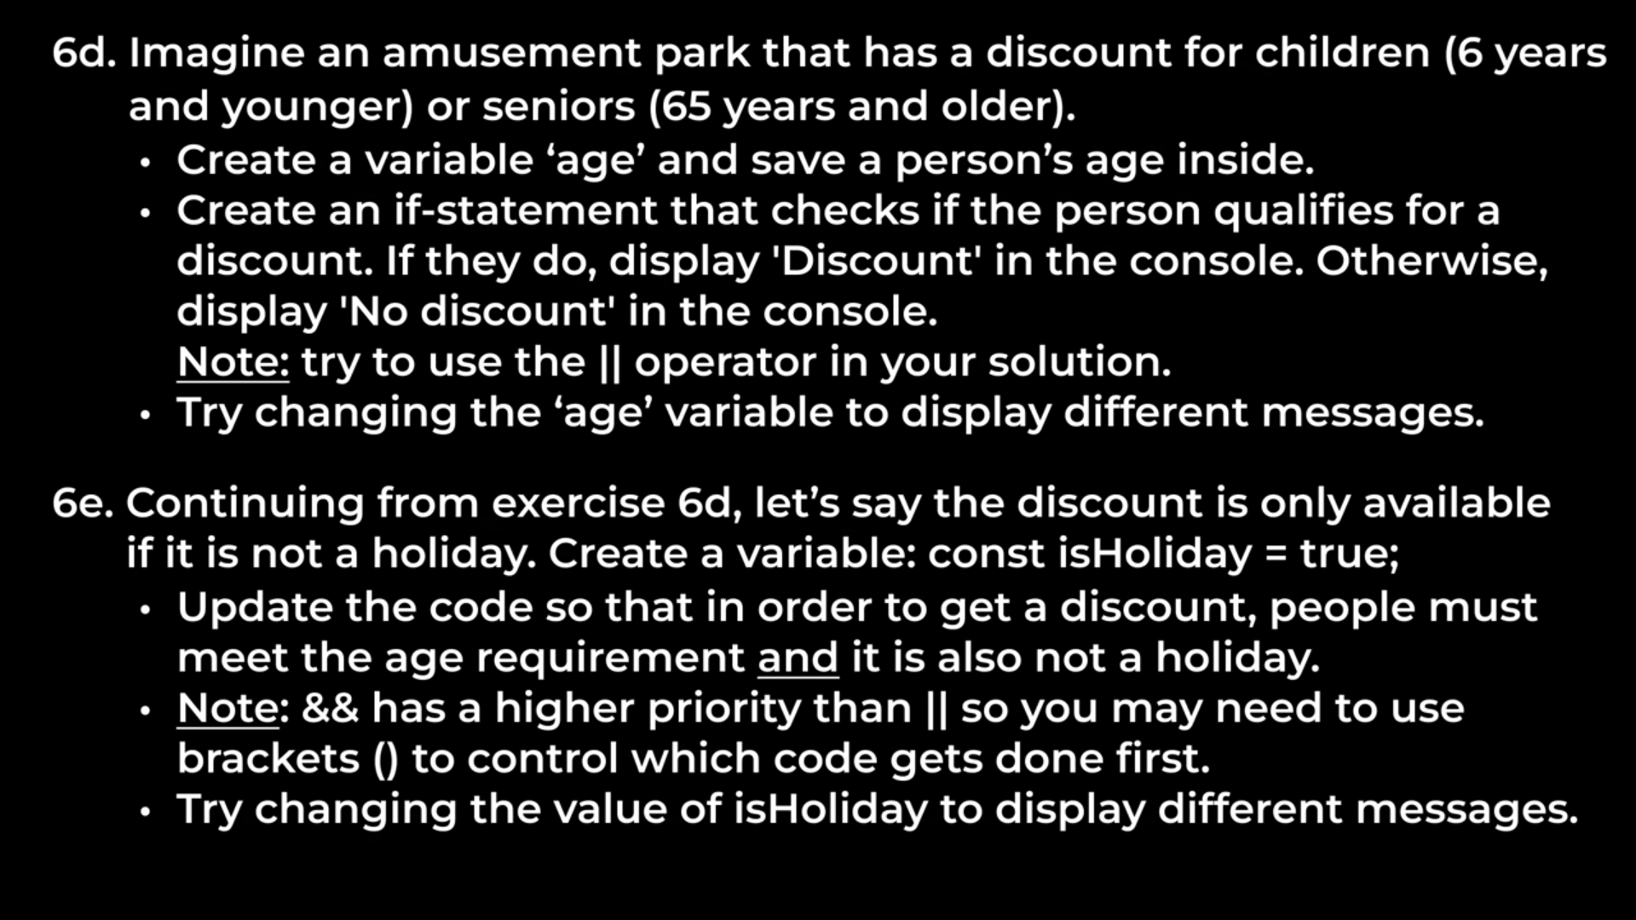

Slide 9
